Slide 1
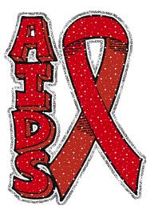
HIV & AIDs
By: Corey Carruthers, Destinee Spangler, Tebvoujhs, Andrez Brundge, Kyle Coger

Slide 2
Introduction
AIDs and HIV are STD’s that effect people worldwide. They are diseases transmitted through sexual contact and can lead to illness or even death.

Slide 3
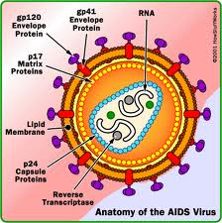
AIDs
AIDs: Acquired immune deficiency syndrome, a disease in which there is a severe loss of the body’s cellular immunity, greatly lowering the resistance to infection and malignancy.

Slide 4
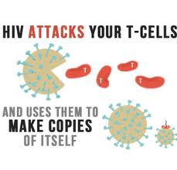
HIV
Human immunodeficiency virus, a retrovirus that causes AIDs.

Slide 5
Symptoms
HIV attacks the immune system, weakening it and making the body more susceptible to infection.
Some symptoms that follow infection are:
Fever, headache, muscle and joint pain, sore throat, rash and diarrhea.

Slide 6
Treatments and Cures
There is no cure for AIDS but medications have been effective in fighting HIV and its complications. Drug treatments can help reduce the HIV virus in your body, keep your immune system as healthy as possible and decrease the complications you can develop.

Slide 7
Research
None of the strategies are easy, proved or ready for prime time. But all involve procedures or drugs that are already in use and are able to be deployed widely if further research bears out the early findings.

Slide 8
History
In the beginning of HIV, it was an unknown and feared virus that was untreatable and often fatal. As the years went on understanding increased and eventually produced a highly effective antiretroviral drug for the treatment of HIV. Even though all of this it still causes many deaths and is incurable.

Slide 9
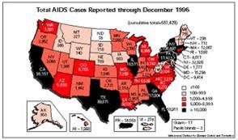
AIDs in the US

Slide 10
US AIDS Rates and Deaths 1990-1993
1990- 120,453 deaths, 100,909 cases reported
1991- 156,143 deaths, 206,563 cases reported
1992- 194,476 deaths, 254,147 cases reported
1993- 234,225 deaths, 360,909 cases reported

Slide 11
US AIDS Rates and Deaths 1994-1997
1994- 49,311 deaths
1995- 49,987 deaths
1996- 37,359 deaths
1997- 20,945 deaths

Slide 12
US AIDS Rates and Deaths 1998-2001

Slide 13
US AIDS Rates and Deaths 2002-2005

Slide 14
US AIDS Rates and Deaths 2006-2010

Slide 15
US AIDS Rates and Deaths 2012-Present

Slide 16
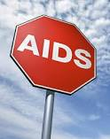
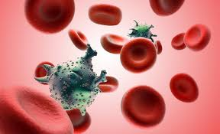
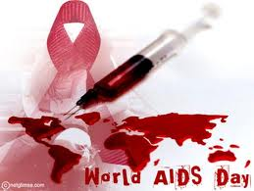
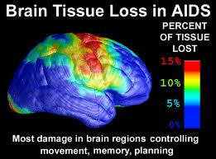
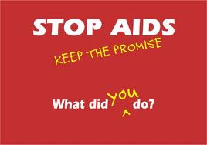
Pictures

Slide 17
Worldwide Statistics
30.6 million adults and 3.4 million children were living with HIV at the end of 2010.
By the end of 2009, the epidemic had left behind 16.6 million AIDs orphans, defined as those aged under 18 who have lost one or both parents to AIDS.

Slide 18
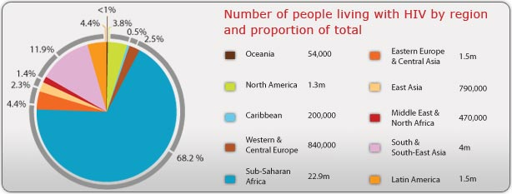
Worldwide Statistics

Slide 19
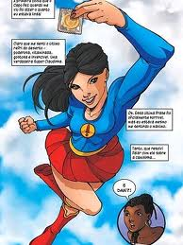
Prevention
Abstinence
Use an appropriate condemn
Don’t share needles

Slide 20
Credits
http://www.avert.org/worlstatinfo.htm
http://partners.nytimes.com/library/national/science/aids/timeline94-97.html
http://www.avert.org/hiv-aids-history.htm
http://www.cdc.gov/hiv/surveillance/resources/reports/2005report/pdf/table7.pdf

